Slide 1

AMCAT Data Analysis
By
Prathibha Maggidi
IN9249087

Slide 2
About me​
My name is Prathibha Maggidi.
I completed my M.Sc in Applied Statistics and currently concentrating on on Data Science by utilizing Statistical methods.
Data science make it possible to create new things,like smarter computers and robots that can do job by themselves.
GitHub : https://github.com/SureshPendem-706
Linkedin : https://www.linkedin.com/in/sureshpendem/

Slide 3
Agenda
Introduction :
The dataset is provided by AMCAT, an organization that tests Engineering students searching for jobs.
The results of the test have been shared with recruiters, who will be conducting interviews for the top-performing students.
Objective :
Evaluate the job titles, salaries, locations, and employment roles for engineering students based on their results from the AMCAT test.

Slide 4
Libraries :
Data Cleaning Steps :
Pandas
Numpy
Seaborn
Matplotlib
Understand the data
Drop one column
Handling missing values
Handling Outliers
Check the Duplicates
Correcting the datatypes

Slide 5
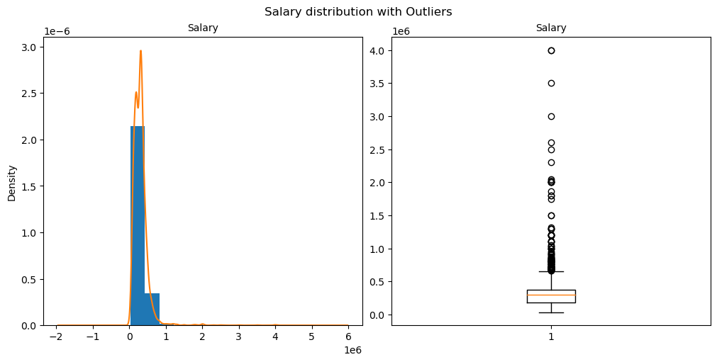
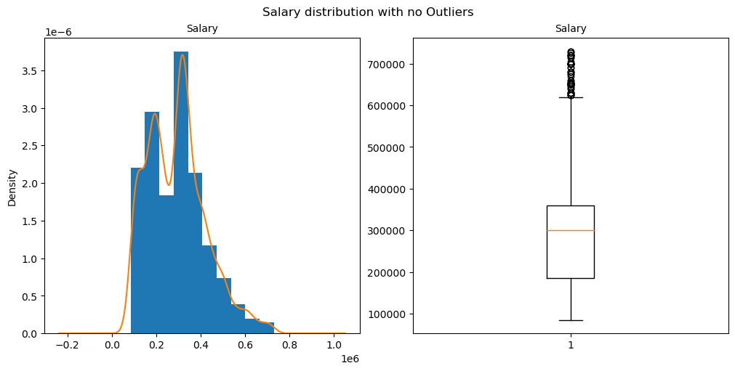
Handling Outliers in Target column : Salary
Before Outliers
After Outliers

Slide 6
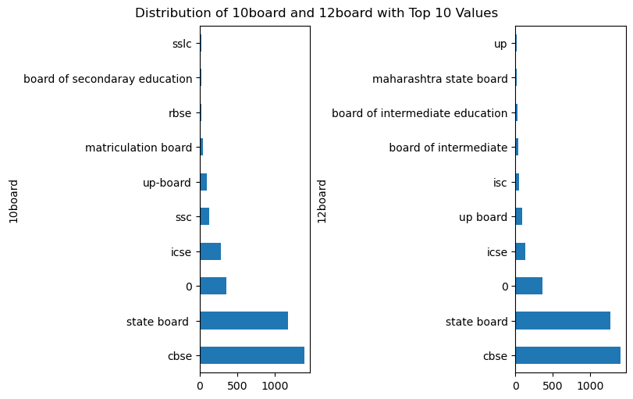
Univariate Analysis : Categorical ​
Most of the students have a background in CBSE for both their 10th grade and intermediate studies.

Slide 7
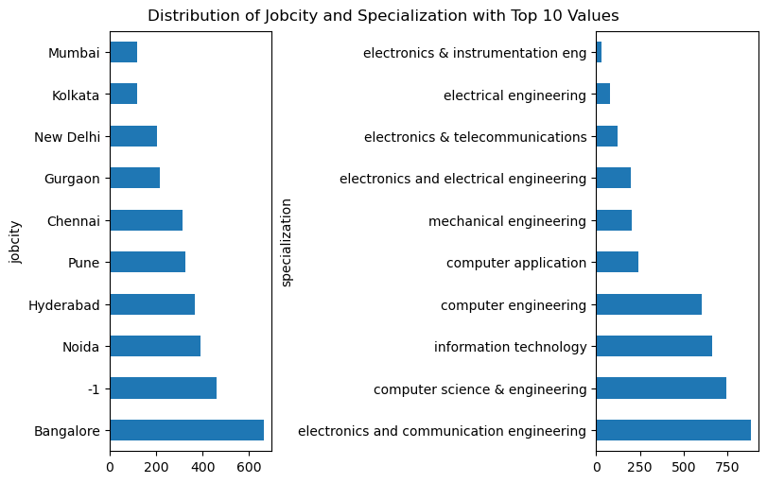
Univariate Analysis : Categorical
Job city : The majority of students secured jobs in Bangalore
Specialization : The majority of students obtained their degrees in electronics and communication engineering.

Slide 8
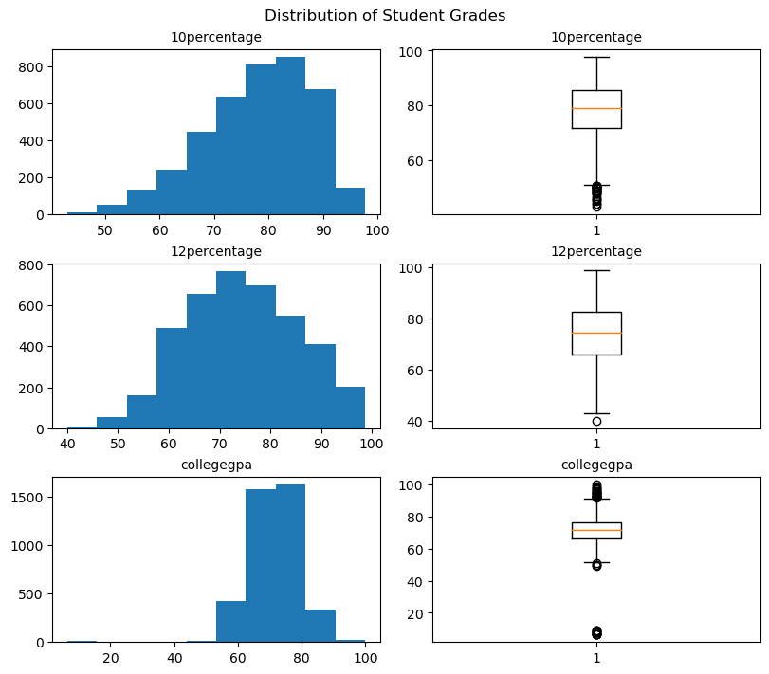
Univariate Analysis : Numerical
The majority of students performed well in their 10th and 12th grades, scoring mostly between 70% and 90%. In contrast, college GPAs exhibit greater variability, with some students excelling while others struggle.

Slide 9
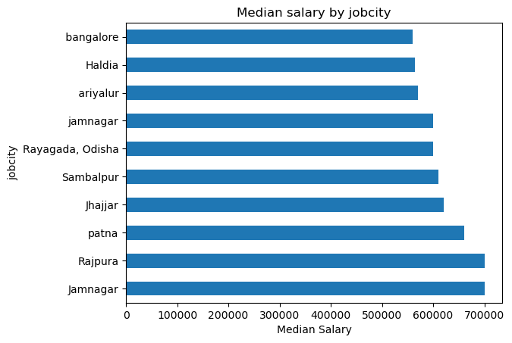
Bivariate Analysis : Numerical​ vs Categorical
Students employed in Jamnagar and Rajpura receive the same average salary, which is higher than that of graduates from other cities.

Slide 10
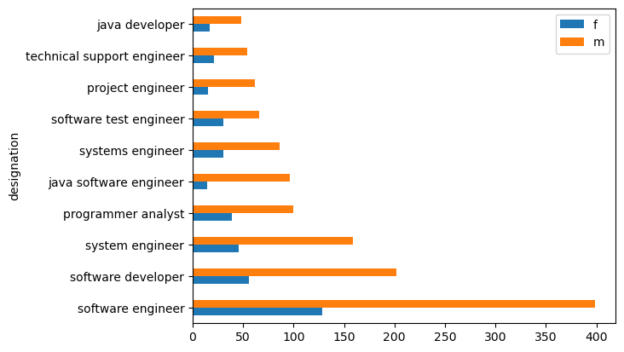
Bivariate Analysis : Categorical vs Categorical​
Males hold a higher number of positions than females in every category, with software engineering featuring the most employees overall, regardless of gender.

Slide 11
Conclusion : ​
Students working in Jamnagar and Rajpura earn the same average salary, and it is greater than the salaries offered in other locations.
In every role, there are more males than females, with software engineering employing the highest number of both genders.
The majority of students performed well in their 10th and 12th grades, scoring mostly between 70% and 90%. However, their college GPAs exhibit greater variation, with some students significantly outperforming or underperforming others.
Job city : The majority of students secured jobs in Bangalore.
Specialization : The majority of students obtained their degrees in electronics and communication engineering.
The majority of students completed their 10th and intermediate education under the CBSE system.

Slide 12

THANK YOU

